Slide 1


Incorporating Ladder Fuels into Empirical Crown Fire Models
Daniel D. B. Perrakis
Dan K. Thompson
Marty E. Alexander
NRCan-CFS
Fuels and Fire Behaviour 2024 – Boise, ID, USA
7th Fuels and Fire Behaviour Conference: Boise, ID, USA
Notes:
Hello to all
I’m pleased to be speaking with you all today, and happy to acknowledge my co-authors in this work.
This is a short talk so I’ll have to just skim over some of the salient details of a fairly complex analysis.

Slide 2
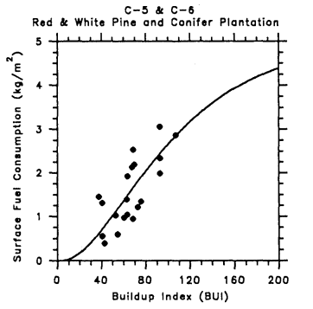
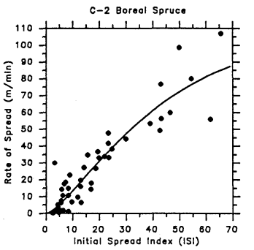
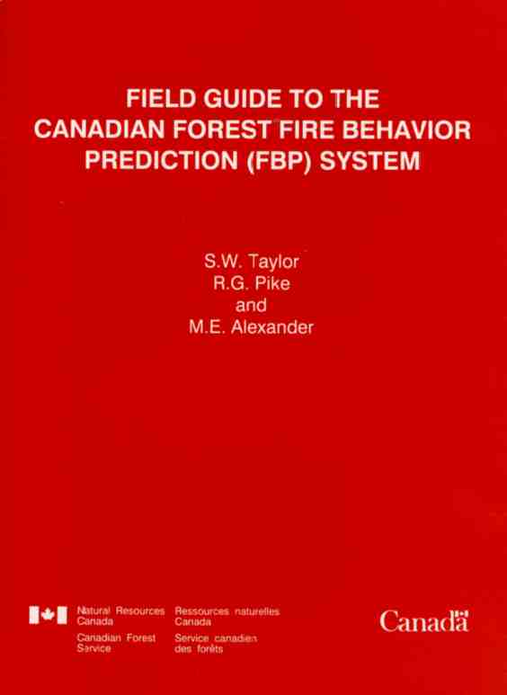
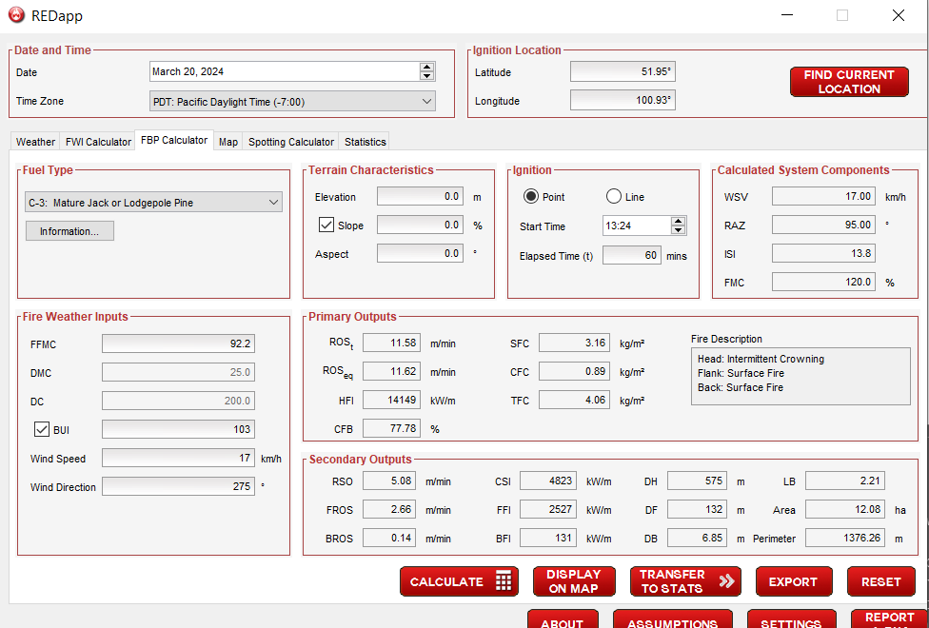
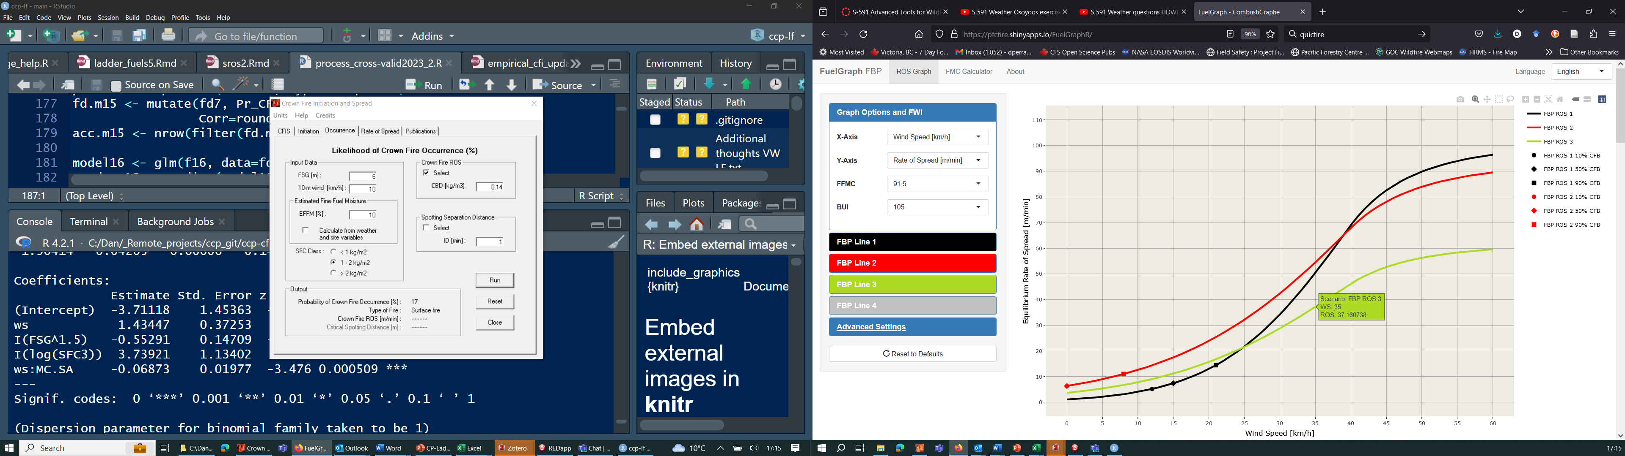
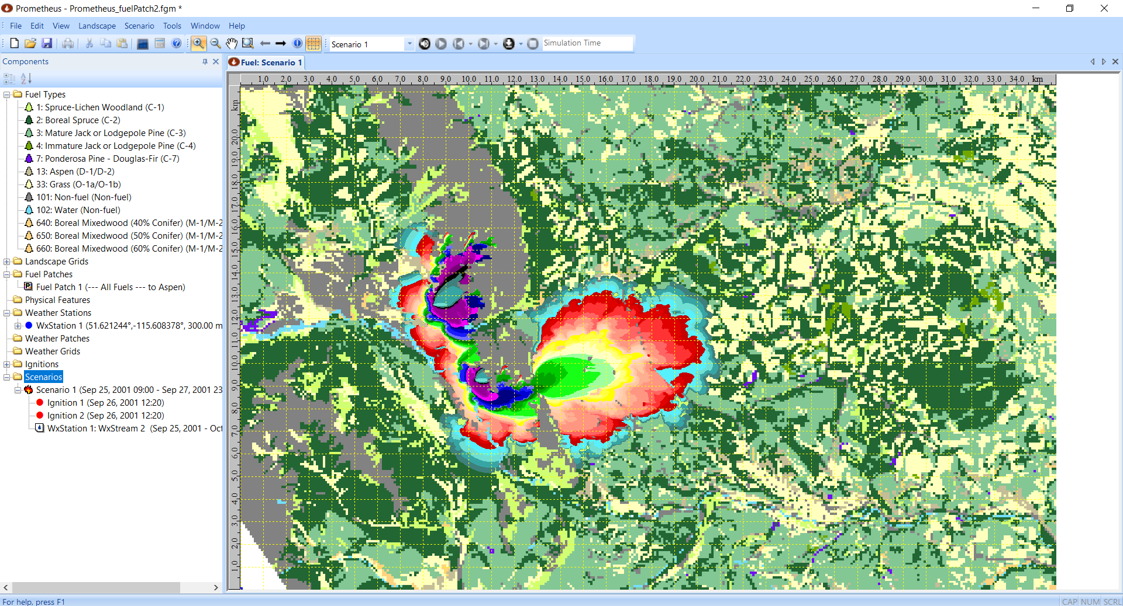
Background: Canadian Forest Fire Danger Rating System (CFFDRS) & Fire Behaviour Prediction (FBP) sub-System:
Semi-empirical system based on fuel types
Fire Weather Index System:
- Fire danger, fuel moisture calibrated to conifer litter beds
FBP System:
- Fire behaviour outputs predicted from FWI inputs and fuel type (FT)
- 7 FTs for conifer stands
- Empirical functions for surf. fuel consumption (SFC), ROS
- Conifer models encompass surface to crown fire behaviour
- Used operationally across Canada since 1990s
Notes:
Any discussion of fire behaviour modelling in Canada generally starts with the Canadian For….
CFFDRS, and FBP sub-system, which has been around in its more or less finished form since 1992
Uses inputs from the FWI system, which predicts fuel moisture in closed conifer stands, and one or more categorical fuel types.
There are 7 conifer types, and each one features empirical functions for predicting fuel consumption and rate of spread.
Conifer fuel type models encompass the full range of fire behaviour type, from creeping surface fires to high intensity active crown fires.
The system has been in use since the 1990s with a variety of associated tools currently in use, from the
Field guide – Steve Taylor
To a variety of calculators, dashboards and applications including the Prometheus fire growth model.

Slide 3
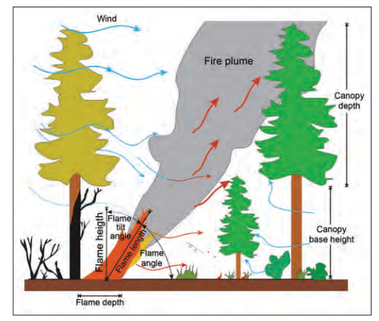
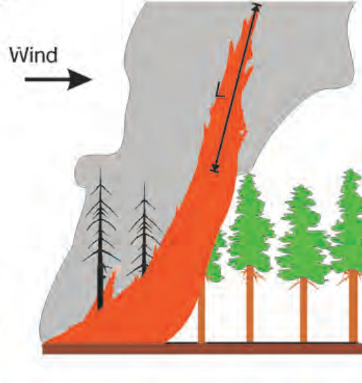
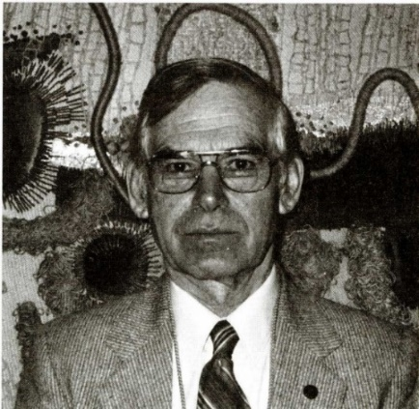


CE Van Wagner (1977) crown fire initiation model:
Physical & conceptual framework for crown fire in FBP System
$$I_{0}={(chz)}^{1.5}$$
I₀: Critical surface intensity for crowning (kW/m)
c: Empirical constant
h: Heat of ignition (kJ/kg) – Van Wagner’s (1968) lab work suggests h=460 + 26 x FMC
z: Live crown base height (LCBH)
Common use: replacing I₀ with Byram’s (1959) fireline intensity equation: I = H x w x ROS
Rearrange to solve for critical sROS (FCFDG 1992; Van Wagner 1993; Scott and Reinhardt 2001)
Surface fire near I₀
Crown fire
(Alexander and Cruz 2016)
Charles E. Van Wagner: 1924-2023
Notes:
Underlying the empirical work is the well-known Van Wagner crown fire initiation model.
This is very well known in the fire behaviour research realm and I don’t have time to go over it in detail.
But in essence it’s a simple, physically-based 1-dimensional model for predicting the initiation of flaming in canopy fuels separated from the ground surface
In the model, critical surface fire intensity for crowning is determined based on the heat of canopy ignition, the crown base height z and an empirical constant c
It is commonly combined with a heat of ignition model and often with Byram’s fireline intensity equation.
In the FBP System it is used to describe surface or crown fire behaviour and associated with crown fuel consumption, but is not tied directly to spread rate, since the ROS models are primarily those empirical functions I noted in the previous slide.
However, to make it work, the Van Wagner model requires a credible surface ROS model and is tricky to apply to complex stands.

Slide 4
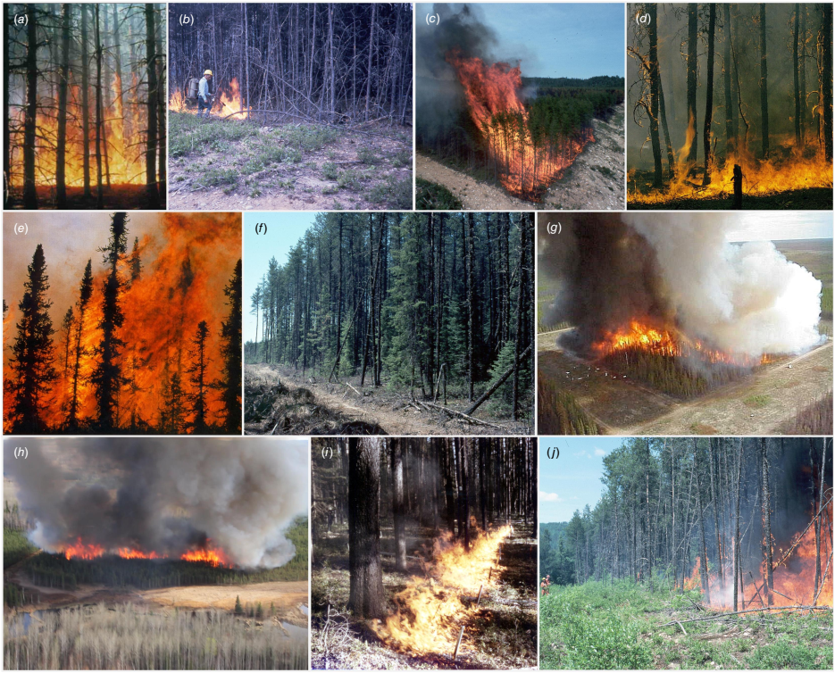
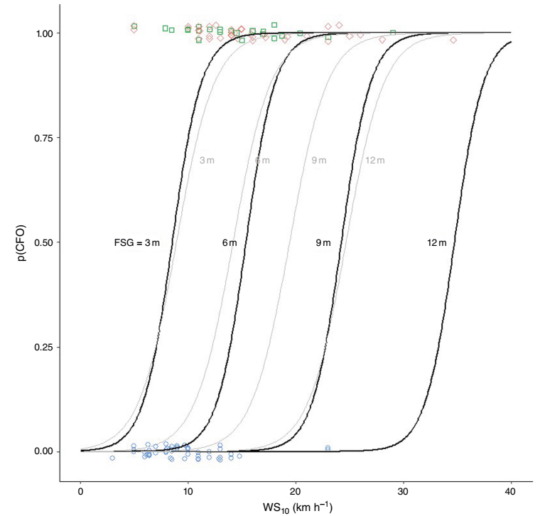
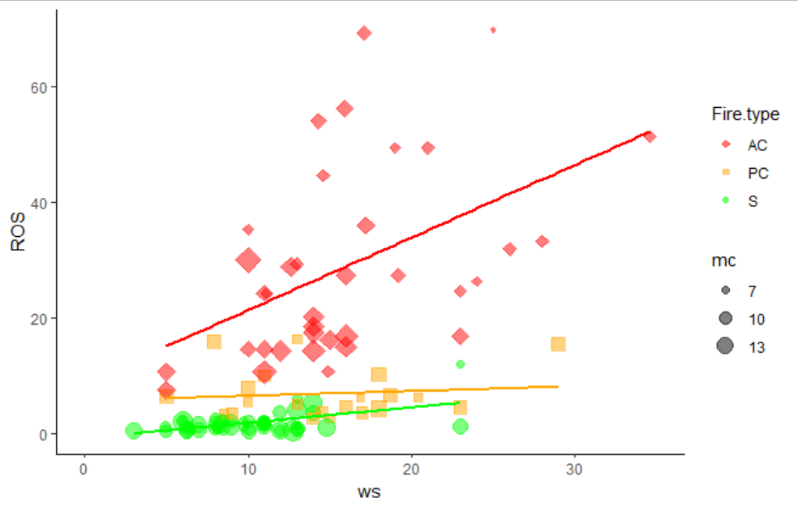
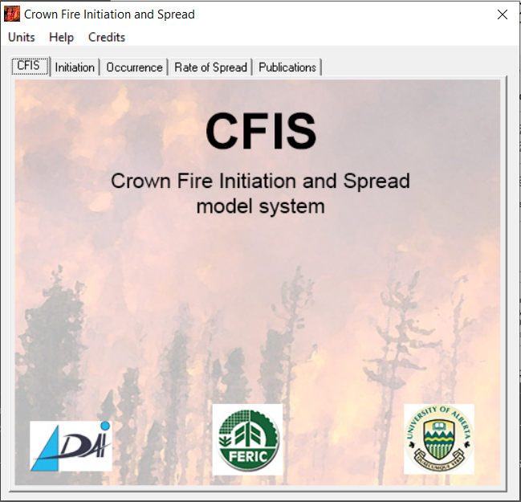
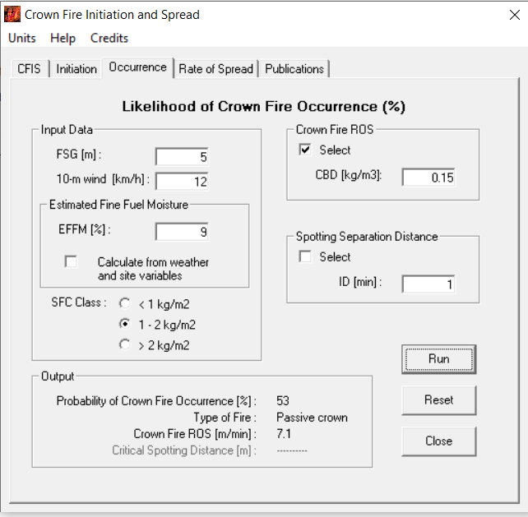
Empirical alternatives:
CFIS (Cruz et al., 2003-2004), ConPyro (Perrakis et al. 2020, 2023)
P(CFO)
FSG=3 6 9 12m
60 Years of field-scale experimental burning projects in boreal, sub-boreal forests (n=113… and counting).
Wind speed (km/h)
Notes:
However well the FBP fuel types work, they are fairly inflexible and few in number, and there has long been interest in empirical alternatives to the Van Wagner model that would be grounded in the experimental data.
Another approach, stepping back from the FBP System organization and fuel types and just look at the raw data from the experimental burning.
This is wonderful set of experiments these burns conducted over several decades across the country. So rather than the physical approach, theCFIS system, crown fire init and spread, was a mini-system developed by Miguel Cruz, working with Marty Alexander and Ron Wakimoto, based on an empirical approach to crown fire prediction. Their papers and software represent a highly usable approach to crown fire prediction.
Last year I worked together with Marty and Miguel to reanalyze some of these data, together with the more recent fire experiments, in an analysis published in the IJWF last year. This figure shows one of the new logistical regression models for crown fire occurrence, with the old CFIS model in light gray in the background. The new models have more data and a more sophisticated analysis in terms of cross validation and testing different model forms.

Slide 5
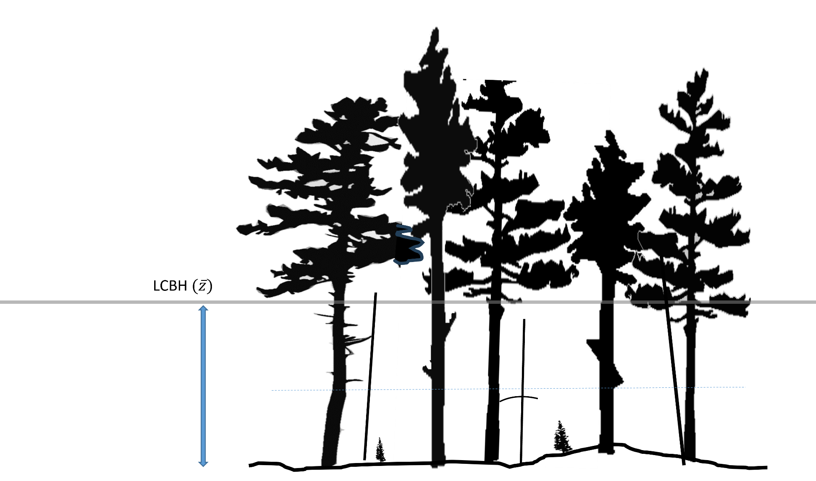
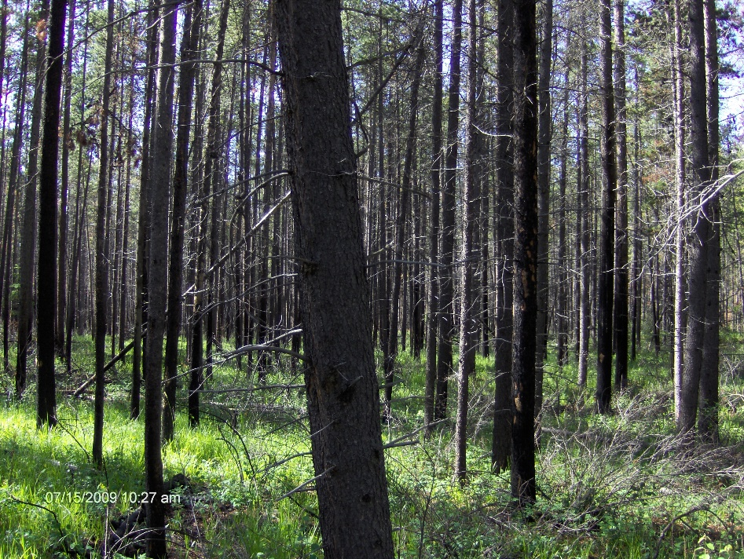
Stand structure and ladder fuels
Challenge:
Van Wagner (1977), other models and linkages assume simple canopy structure.
E.g. mature pine sp. stands
Simple conifer stand with clear separation (≥ 1-2 m) between surface fuel bed and canopy fuels; minimal ladder fuels.
Notes:
So - one of the drawbacks of all these models of crown fire is that seem to work and are mainly valid for stands where a clear separation of at least a metre or two between the surface fuelbed and the base of the canopy fuels.
Crown fire initiation is believed to occur when the combination of radiant and convective heat flux from surface fire is sufficient to ignite the base of the canopy fuels.
As Van Wagner noted in his paper so long ago, there are always some small contributions from bark flakes and small bits of ladder fuels or bridge fuels, but the main theory was drawn from the estimated flame size of the surface fire.

Slide 6
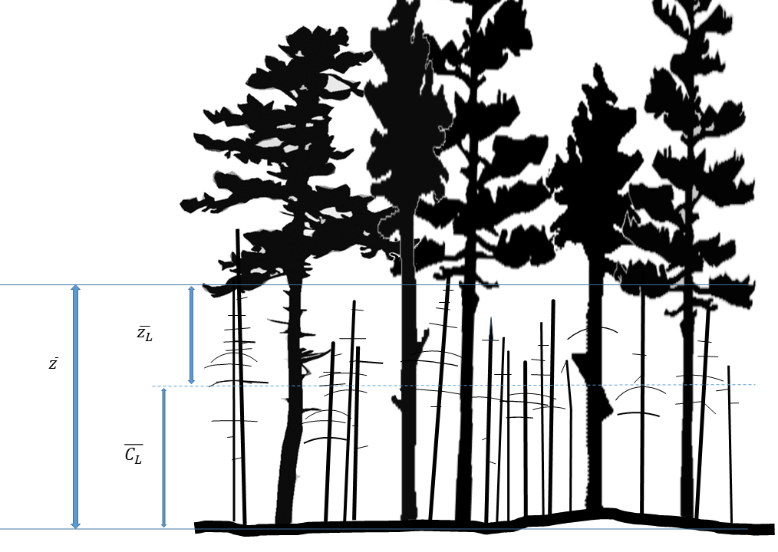
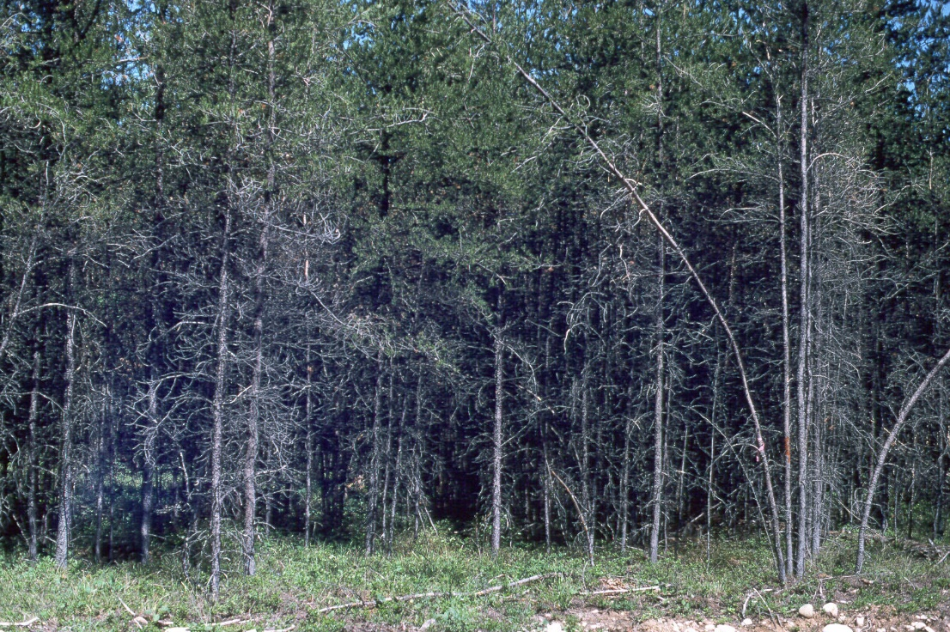



Stand structure and ladder fuels: standing dead woody fuels
Challenge 1:
Standing dead ladder fuels are common in mid-successional stands
$z_{L}$
$\overline{z}$
$C_{L}$
Single-story conifer stand, abundant standing dead ladder fuels (LF). Estimate LF consumption as < 1 cm particles (as per Stocks 1987)
E.g. Jack pine, Sharpsand Creek, ON, Canada
(CFS archives)
Notes:
But of course this is a talk about ladder fuels. It’s very common for ladder fuels to be present in significant abundance, as in this example of a jack pine stand undergoing self-thinning, about 30 years after a wildfire in central Ontario.
This photo is from the well-known Sharpsand Creek, Ontario site, where Brian Stocks and others did experimental burns in the 1970s. The overstory is about 12 m tall, with about 9000 s/ha live jack pine, and there was also about 10,000 s/ha of dead saplings.
I’ll get to the details in a couple of slides, but you can see where I’m going with this. The idea is that if we have this sort of structure, we could come up with an estimate of the elevated fine woody fuel loading below a size class threshold, 1 cm in diameter, which we would expect to burn in a vigorous surface fire, assuming good connectivity with the surface fuels. The vertical centroid of these fuels, called CL, can be described, and would be somewhere below the actual live crown base height. The distance between this ladder fuel centroid, CL, and the actual LCBH represents a relevant Fuel Strata Gap for ladder fuels.

Slide 7


Use of VW77 model in complex stands – Current compromises
Challenge:
In complex stands (multi-layer, abundant LF), most crown fire models require simple canopy structure assumptions:
-Threshold ‘max running mean’ method?
- Mean overall LCBH across layers?
Also, subjective adjustment to LCBH for FSG (CFIS, ConPyro)
Key Questions:
- How to quantify ‘simple’ LF
- Multilayer stands: if lower stratum crowns, will upper stratum be engaged?
Stand structure at Kenshoe Lake, ON, showing distribution of overstory heights and LCBH for jack pine and black spruce
Notes:
Fuel structure: modelling LCBH, or more specifically, Fuel Strata Gap.
One of the trickier aspects of all this is what to do about the source data. The most labour-intensive and somewhat thankless parts of this was to try to ensure that fire environment measurements were collected consistently by various individuals across this wide range of projects over a 50 year period. And when they weren’t – what could we do about it.
Some of the cleanest early work was done by Brian Stocks, who was taking detailed forest inventories way back in the early 1970s in his experimental burns in central and northern Ontario.

Slide 8





Theoretical model: rescaling LF based on VW77
$$I_{0}=(chz)^{1.5}$$
Start with VW77 crown fire init. model
Replace I₀ with Byram’s (1959) HFI
Solve for SFC₀ – critical SFC for crowning
Ratio of SFC₀ at two different heights – if sROS and all constants are the same immediately prior to crowning
Result is method of ‘adjusting’ fuel consumption to compare SFC₀ at different heights (distance from LCBH)
$H∙SFC∙ROS=(ch)^{1.5}∙z^{1.5}$
$$SFC_{0}=\frac{{(ch)}^{1.5}∙z^{1.5}}{H∙ROS}$$
$$\frac{SFC_{2}}{SFC_{1}}=\frac{\left[\frac{\left({\left.ch\right)}^{1.5}∙z_{2}^{1.5}\right.}{H∙ROS}\right]}{\left[\frac{\left({\left.ch\right)}^{1.5}∙z_{1}^{1.5}\right.}{H∙ROS}\right]}$$
$SFC_{2}={\left[\frac{z_{2}}{z_{1}}\right]}^{1.5}∙SFC_{1}$
Notes:
So I started with the perspective of the Van Wagner crown initiation model.
And I quickly found something that seemed pretty powerful – I don’t know if this has been done before; I couldn’t find in the literature, despite the hundreds of papers and analyses that have been done with it.
So if you replace critical fire intensity with Byram’s equation, this is the stage where nearly everyone solves for ROS
But if you solve for SFC, it looks like this. You can consider this the critical SFC for crowning for a given z and ROS
And if you consider the ratio of two levels of SFC, representing two different z values but the same ROS – it seems fairly reasonable to assume surface ROS is independent of CBH, you get this relationship. All the other constant terms fall out and you’re left with this relationship between SFC and crown base height.

Slide 9

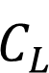

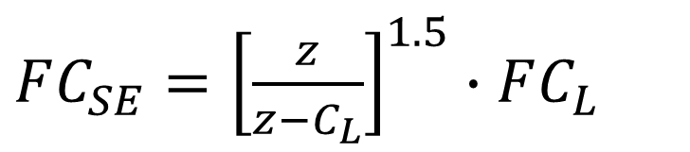

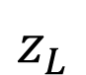
Theoretical model: rescaling LF based on VW77
Model inflates ladder fuel consumption (FC_{L}) to ‘surface-equivalent’ consumption (FC_{SE})
FC_{SE} can be added to actual SFC (ground) to adjust crowning tendency
Note 1: Div by 0, extreme inflation issues as z – C_{L} diminishes
Note 2: Does NOT adjust for differences in structure (bulk density, etc.) between SF, LF
Possible multiplier (M) solution, where
Solve for M using exp. data, Byram’s eq.
Test LF equation with and without M
$FC_{SE}={\left[\frac{z}{z−C_{L}}\right]}^{1.5}∙FC_{L}$
$z_{L}$
$\overline{z}$
$$SFC_{LF}={FC}_{SE}∙M$$
$C_{L}$
Notes:
So changing the variable names slightly, we can see what we have ended up with and what this looks like in our
simplistic forest profile.
The model defines surface equivalent FC, which is the scaled value from the ladder fuel consumption brought down to the surface
And theoretically, this value could be used in an additive fashion with the actual surface fuel consumption.
We immediately note two important caveats -
And finally, there is the tricky business of assuming that surface fire will ignite these standing ladder fuels and burn them as part of the fireline, or perhaps estimating what would be required to ignite them. For the present purposes, I assume that the fineline intensity is sufficient to ignite and consume fine branchwood.
So for this business of a multiplier, we turn to experimental data.

Slide 10
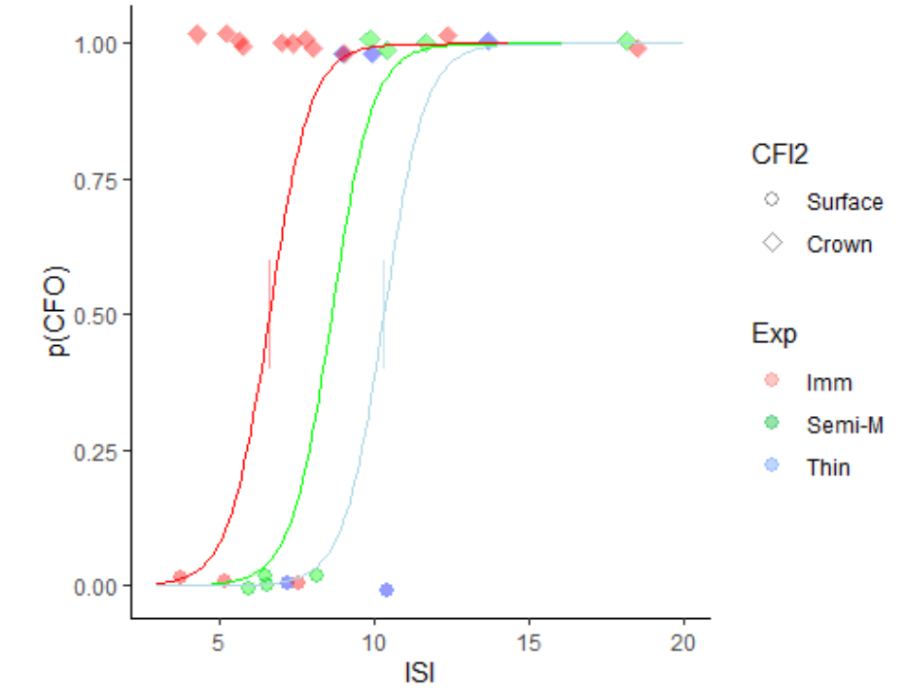
Solving for M: Sharpsand Control, Thinned, Semi-mature
Sharpsand Creek jack pine experimental burns, 1974-1991
Control - immature/ overstocked
9,849 dead s/ha; LCBH=4.4 m
Thinned jack pine
1175 dead s/ha; LCBH=4.4 m
(Semi-mature jack pine
3830 dead s/ha; LCBH=5.3 m)
Crowning thresholds (p=0.5) from logistic regression of S and C fires:
Control vs Thinned:
ISI₀=6.6 vs. ISI₀=10.3
Stand-adjusted: Isa₀=4.70 vs. 9.2
sROS models used to solve for M
+ +
Crowning thresholds (+) between sites and fuel structures, Sharpsand Creek.
Notes:
Among all the experimental burn sites, the Sharpsand Creek site was the most fruitful in terms of number of burns. With a total of 27 experimental burns lit over an 18 year period (1974-1991), including some plots that had been pre-commercially thinned.
When first measured and in the first burns in about 1974-75, these stands, only about 25 years old naturally regenerated after a natural wildfire, were in the full throes of the stem-exclusion phase, rapidly transitioning from tens of thousands of small saplings to just a few thousand s/ha of larger trees. So at the time of measurement they had about 10,000 live trees/ha, and about 10,000 dead trees/ha, whereas by the mid-1980s, 10 years later, the live density had dropped by over half and the standing dead trees by 2/3. These three treatments gave just enough surface and crown fires to be able to make a statistically significant logistic regression model fitted to ISI and treatment type. And we can immediately note two different threshold ISI values, 6.6 and 10.3. With the LCBH being identical in the two stands and no evidence for different surface ROS, the difference can be attributed to the ladder fuels and used for an initial calibration of our model.

Slide 11
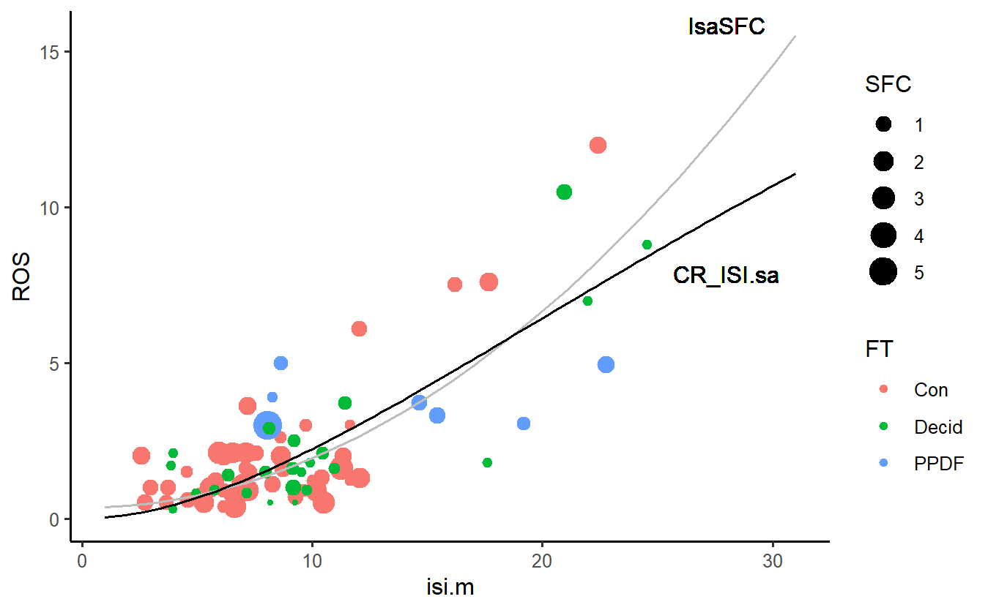
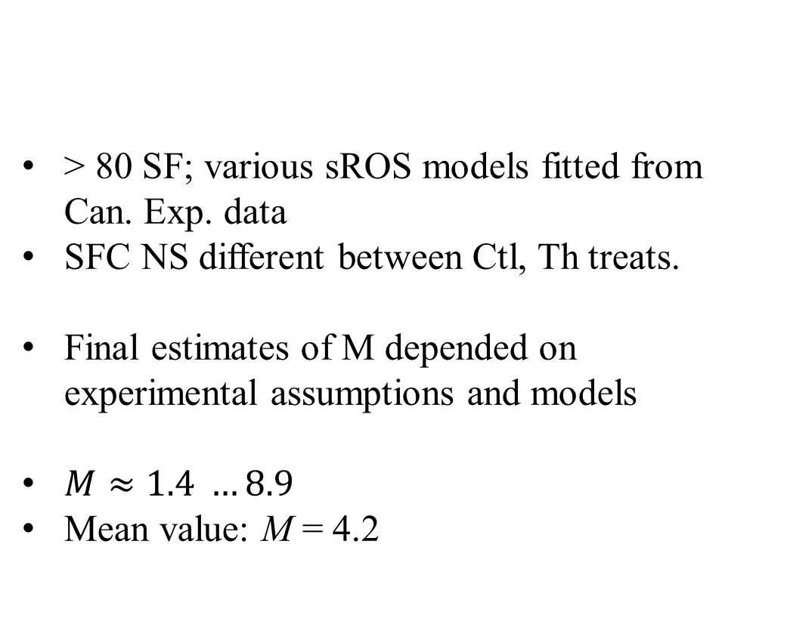
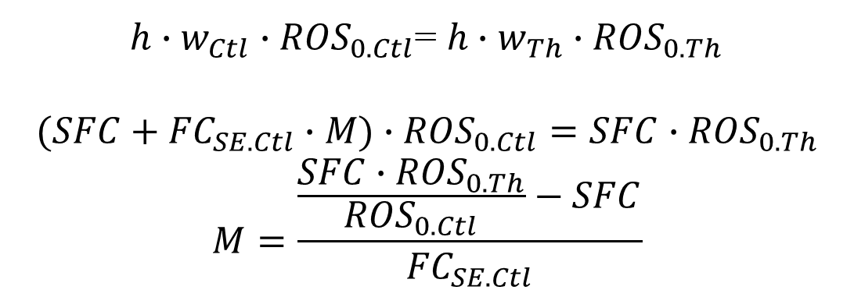
Final estimates of M, ladder fuel multiplier
$h∙w_{Ctl}∙{ROS}_{0.Ctl}$= $h∙w_{Th}∙{ROS}_{0.Th}$
$$(SFC+{FC}_{SE.Ctl}∙M)∙{ROS}_{0.Ctl}=SFC∙{ROS}_{0.Th}$$
$$M=\frac{\frac{SFC∙{ROS}_{0.Th}}{{ROS}_{0.Ctl}}−SFC}{{FC}_{SE.Ctl}}$$
> 80 SF; various sROS models fitted from Can. Exp. data
SFC NS different between Ctl, Th treats.
Final estimates of M depended on experimental assumptions and models
$M≈1.4 …8.9$
Mean value: M = 4.2
ROS (m/min)
Stand-adjusted ISI
Fitted sROS models, Can. experimental burn dataset (boreal conifer, Ponderosa pine, aspen)
Notes:
So, to do this empirical solving, we needed a surface fire model, which is something that isn’t really part of the FBP System.
The good news is that with almost 90 SF data points there were enough observations to show a clear relationship with ISI
We could then use these values to solve for M empirically.
The bad news is that all these variables are quite sensitive.
So these ROS models are quite sensitive to ISI or Isa values, and measured SFC in the burns was not significantly different, but kind of marginally different, with a p value of about 0.08.
So depending on which models you use and assumptions regarding ladder fuel centroid height and fuel consumption, I came up with estimates for M of about … mean value of about 4

Slide 12
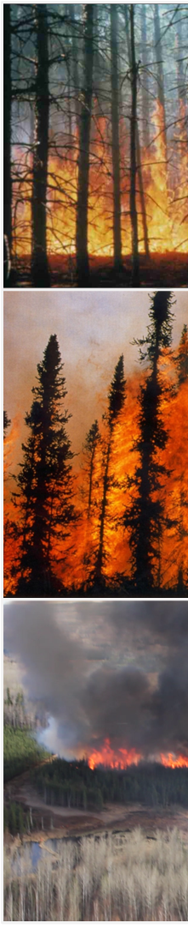
Incorporation into Crown Fire Model
Cross-validation (4-fold, 1000 x) on 113 SF, CF obs (M=4):
Best models using mc_{FFMC}, mc_{SA} DO include M factor to boost LF
Models including LF contribution (as FC_{SE}) performed better than base LCBH models, and at least as good as subjectively-adjusted FSG-based models

Slide 13
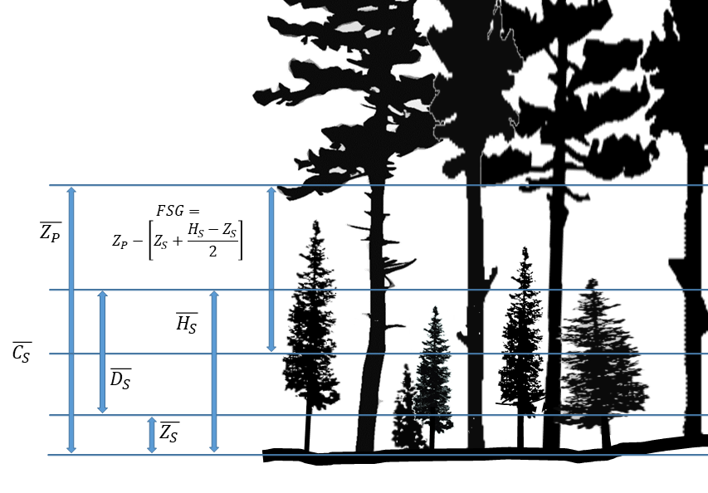
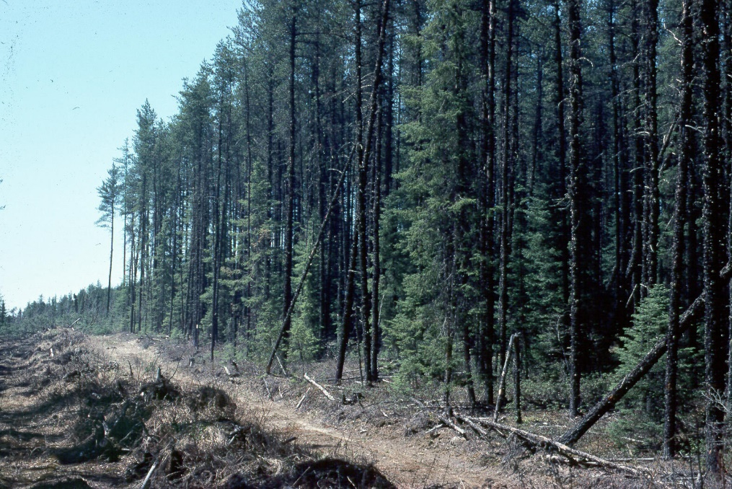



Stand structure and ladder fuels: Dual layer conifer
Challenge 2:
Dual-layer conifer stands also very common – understory, mid-story act as ladder fuel for overstory crowning
$z_{L}$
$\overline{z}$
$C_{L}$
Two storey conifer stand. Estimate crowning on lower layer first, then compute FSG from lower crown centroid to upper z.
E.g. Mature jack pine / black spruce, Kenshoe Lk, ON, Canada (CFS archives)
Notes:
But of course it’s very common for ladder fuels to be present in significant abundance.
Another scenario that’s exceedingly common, in all sorts of conifer ecosystems, is a dual layer stand, typically with a shade-intolerant overstory, such as a pine species, with an understory of a shade-tolerant species, such as spruce or true fir such as balsam fir or subalpine fir
In the Canadian experimental fire database, there are a couple of sites where this structure was repeatedly burned, including at Kenshoe Lake, Ontario, as shown in this photo
And as we start thinking about how a simple crowning model could work in this situation, there are some additional fuel structure measures that matter – things like the understory or mid-story layer canopy dimensions, and distances between the fuel layers. This is taking the Fuel Strata Gap notion to the next level. And obviously, the level of complexity in some stands could get much higher, with quite a few more than two species or layers, and horizontal clumping and spreading patterns to consider as well.

Slide 14
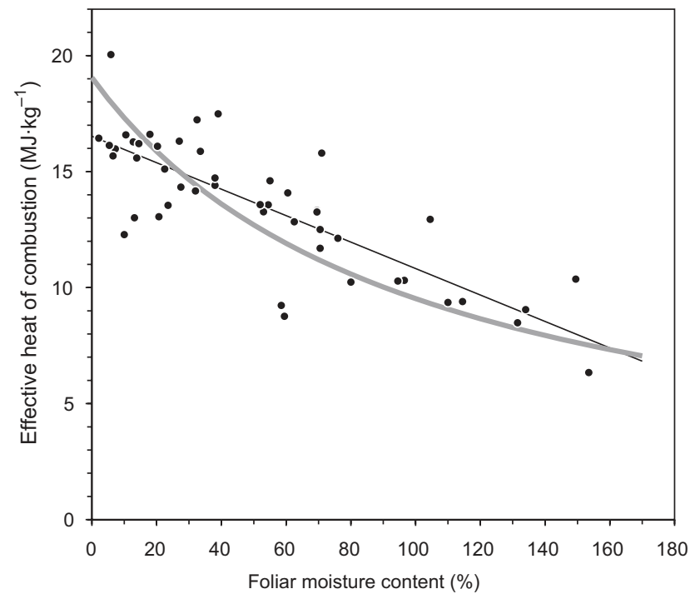
Application & conclusion
Ladder fuel scaling equation (FC_{SE}) incorporated into crown fire probability model (n=113)
With, without M (M = 1 vs. M = 4))
Requires estimates of < 1 cm loading
Assumes all LF are consumed during flaming front
Results promising – accuracy, AIC with M and LF gave best results
2-storey crowning possible by using LF equation in the opposite way – reducing actual SF to add to CFC for second test of crown fire probability
Also requires foliar flammability model (e.g. Babrauskas 2006) to compare MC values of ~ 80-130 to MC vals of ~ 5-15.
14 / 15 upper crowning cases correct (Kenshoe Lk, ICFME)
Initial results promising – but more validation needed
Convert from live FMC to equivalent H in dead fuel (mc); e.g. Babrauskas 2006.

Slide 15

References
Babrauskas, V. 2006.
Byram 1959
Cruz, M. G. 2003-2005
Perrakis 2020, 2023
Van Wanger 1968, 1977, 1993
Scott & Reinhardt 2001
Stocks 1987
FCFDG 1992
Notes:
Break –

Slide 16
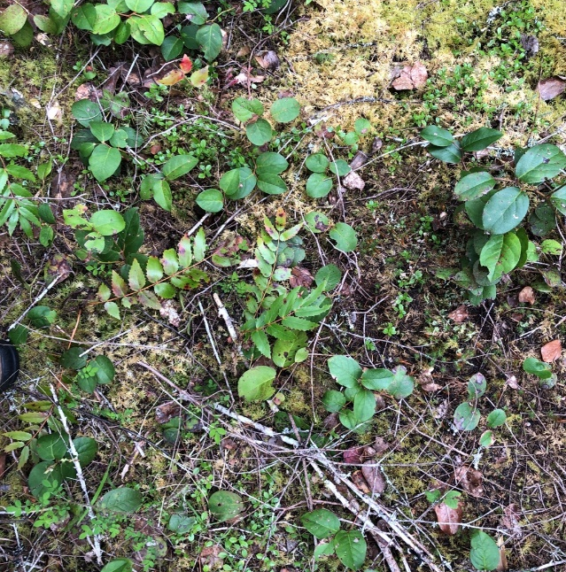
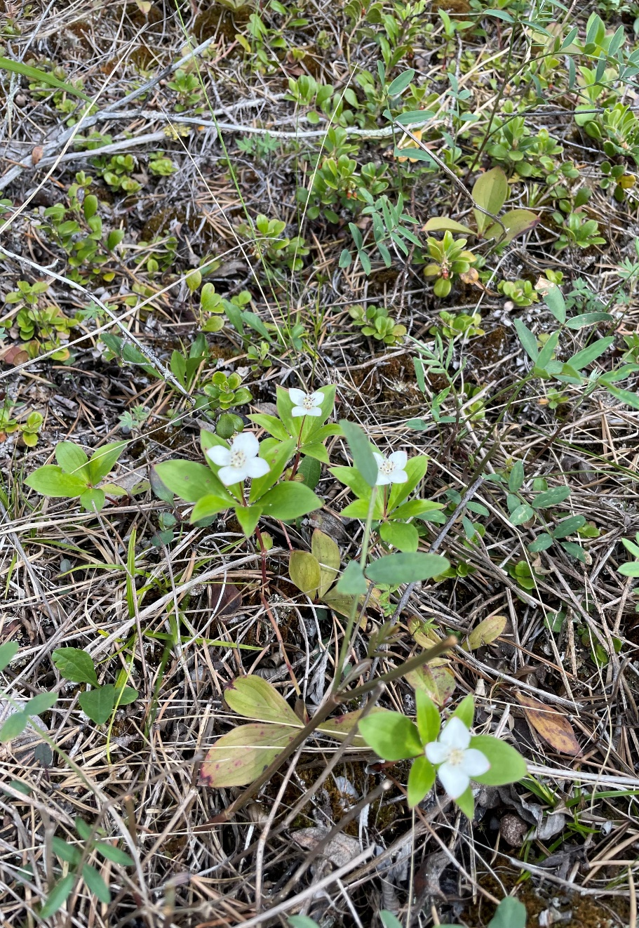
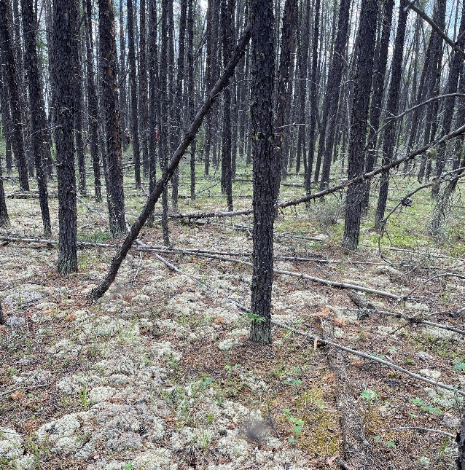
Litter moisture Content Models: FFMC, MC_{SA}
Moisture content (mc or MC) of dead litter (needles, bark flakes, fine wood) critical for fire behaviour
In FBP, estimated using weather alone: FFMC
Based on ‘Generalized pine forest’
Not sensitive to species or structure
Same for pine, spruce, balsam, aspen, hemlock, oak, tamarack, redcedar/white-cedar, etc.
No curing factor for understory herbaceous
Addressed in FBP ROS and SFC functions by fitting to FFMC (ISI)
Notes:
So we’ve already talked about some of the issues with our FWI codes being insensitive to stand condition – indices based on weather alone designed to represent aspects of fuel moisture, litter, upper duff, deep duff and large wood, but actual MC varies considerably based on stand characteristics. But in the FBP System it works out mostly ok because the ROS and consumption curves are fitted on the ISI, calculated using the FFMC, not on actual fuel moisture.
So when we decide we want to convert to actual fuel moisture including stand influence, we have to be very careful, because there’s so much variability, and all sorts of forest ecology factors start becoming important – things like seasonality and understory vegetation and soil type.

Slide 17
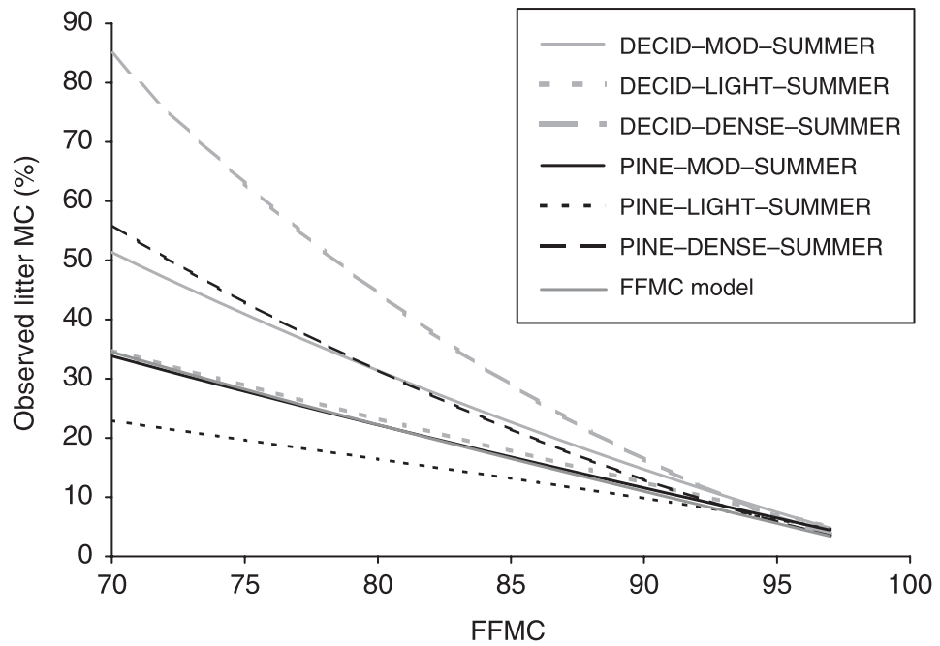
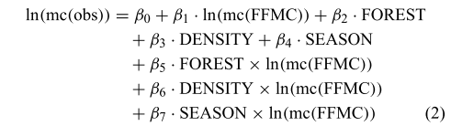
Stand-adjusted moisture content (MC_{SA}) - Wotton and Beverly (2007)
Incorporate stand variables into dead fuel MC
Calculated via adjustments to base FFMC: stand type, characteristics, condition
Statistical analysis of historic test fire data: 1939-1961, FFMC> 75, n=6853; median measured MC of 16%
Final model:
mc ~ FFMC, DMC, stand type (cat.), density (cat.), season (cat.)
Stand categories decrease in skill above FFMC 93
MC_{SA}:
Notes:
One nice effort to address this – to incorporate some stand variables into MC estimates came out in 2007 by Mike Wotton and Jen Beverly
Frankly this paper should have made a bigger splash in the Can. FB community than it did. It’s a bit quirky, but offers some nice additional flexibility compared to base FFMC and ISI.
paper that analyzed all the old moisture data from the early- mid 20th century.
Very large sample size, very nice range of data. All relationships (highly) statistically significant, focussed only on moderate to high fire danger FFMC levels.
There is some criticism of field data on moisture content studies; they often have a lot of data from high moisture conditions, moisture contents of 25-30% or higher, correspond to FFMC values in the 70s or so – these aren’t very useful. Day to day moisture content on wildfires that grow to any sort of appreciable size has to be below 10-15%; with many cases of single digits – moisture contents of 8, 7, 6 %; down to 3 or 4 percent in extreme cases, like in southern interior BC.
Anyway, this study had a large dataset, with nearly 7000 observations; Median moisture content was 16%, so there’s at least half of these observations which are useful

Slide 18
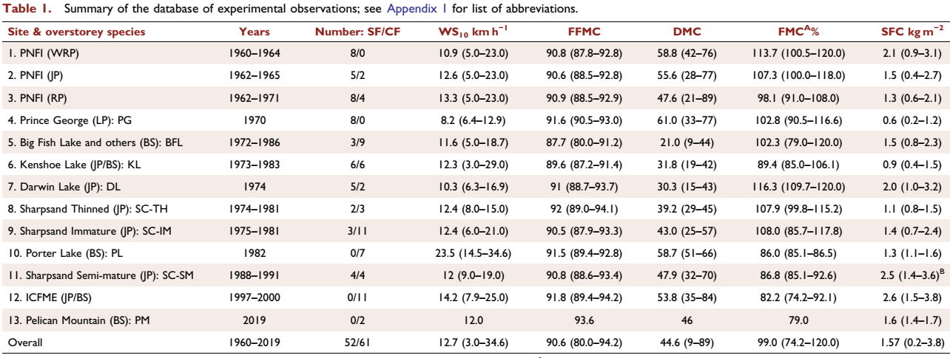
CFO: Dataset
Notes:
Ok,
The bulk of this dataset that made up the FBP System actually breaks down to individual fire experiments at a finite number of sites across Canada.
Examining the evolution of the main experimental burn dataset bring us to a table such as this one
Earliest burns by Van Wagner in 1960 through various projects in Ontario, Alberta, the NWT, and one in BC
The FBP data was complete by 1986, but a few projects kept going, including some additional burning in the heavily stocked jack pine stands of Sharpsand Creek, results only finally published in 2017.
And then the International Crown Fire Modelling experiment in the 1990s, which was not considered part of the FBP System but was designed to test a physical crown fire model
Experimental burning has not completely died since then, and a few notable projects have been completed in the early 2000s, notably the Pelican mountain project, a couple of plots burned in 2019.

Slide 19
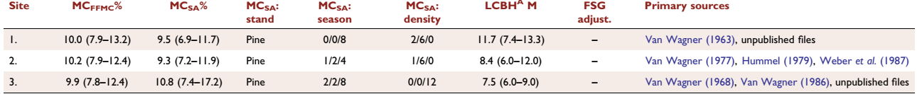
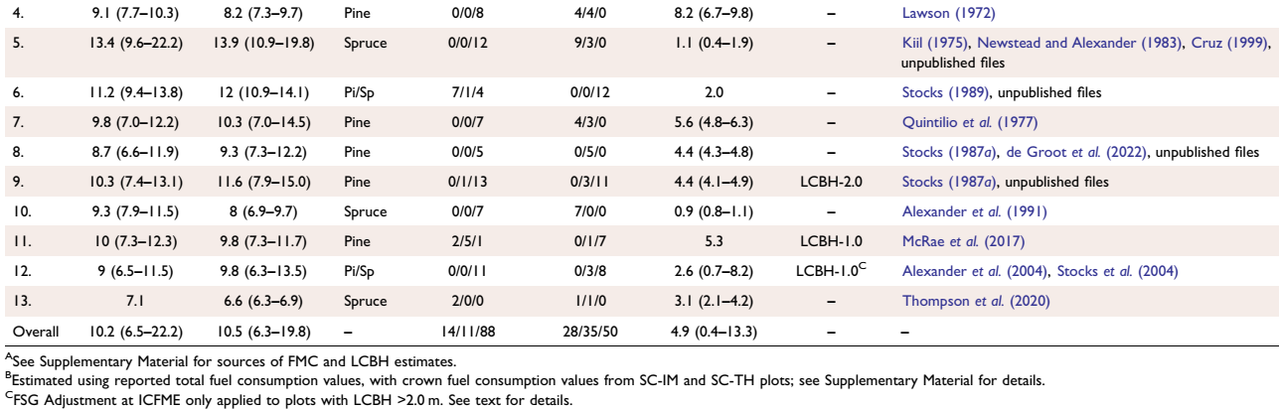
CFO: Dataset
Notes:
Here’s the rest of it, highlighting the stand-adjusted moisture content work, LCBH, and the adjustments to get FSG.

Slide 20
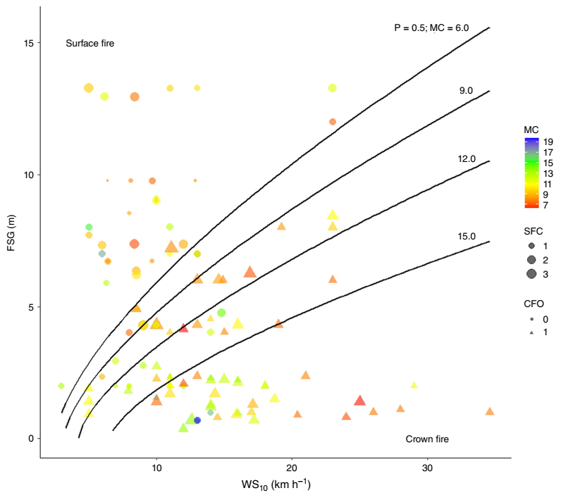
Results: Model 11
CFI Model 11:
113 experimental fire obs. (ws, FSG, SFC, mc), with P=0.5 isolines at indicated mc levels (6-15 %; calculated at 1.5 kg/m² SFC).
Notes:
In terms of interpreting what’s going on - here are the results of the new crown fire initiation reanalysis, showing the spread of data along four main variables, ws horizontal, FSG vertical, size of symbols represents SFC and colour represents moisture content. And the shape represents observed crown fires vs surface fires, as reported by original experimental burn observers. as predicted by the Wotton-Beverly model. The lines are the 50% probability lines, calculated at various moisture contents as shown.
The second figure shows the probability of CFI, at different FSG values as wind speed increases; calculated at median SFC of 1.4 kg and 9% moisture content
It does take a while to wrap your head around these data – the point is, SF at top left, CF at bottom right
Lines are the breakpoints between them, calculated under standard conditions
And yes, we could use more data. From experimental fires, from documented wildfires, and so on. You can see gaps in data space at the right side of the graph – high wind conditions (highest is Porter Lake; several pine experiments from 23-25 km/h wind speeds conducted way back in the 60s by Van Wagner) – in general, could use more high end observations in pine stands , Douglas-fir stands, or any high crown conifer.

Slide 21






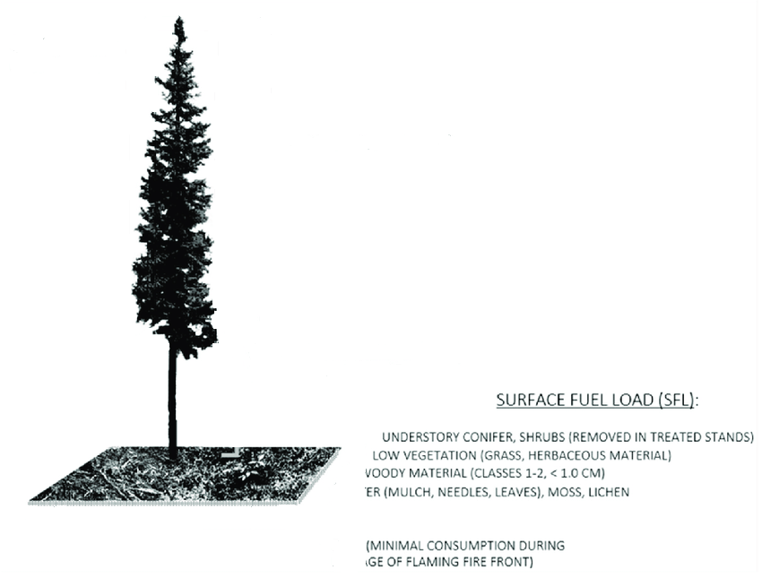

Two Strata Canopy Stands
Notes:
Ok so here’s your classic 2-layer stand. It’s usually a shade intolerant species up top, often pine – jack pine, lodgepole, ponderosa, etc.
Underneath you have a shade-tolerant species –black spruce, balsam fir, etc.
We’ve always struggled with what to do with these.
Clearly, this is a vertically bimodal distribution of crown fuels.
I’ve drawn this a bit simply here, eh? Here it’s a distinct layer, with several trees that are roughly the same size
That isn’t always the case; rather, the norm is high variability, particularly in the shade-tolerant layer; some trees will be poking right up into the upper canopy.

Slide 22



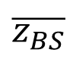
$$\overline{z_{BS}}$$
Notes:
Step 1:
Evaluate prob. Of CFI in lower stratum (spruce, true fir like Balsam or Subalpine, hemlock?)
Measure or estimate midstory LCBH – all trees above DBH (sometimes set a DBH cutoff, e.g. 3 cm)
What you need to consider is how widespread in your stand or area of interest is that stratum
Typically these mid-story conifer layers are a bit discontinuous
It may be that you have something that is relevant to ½ your stand, or patches
Anyway, that’s true for the whole fuel complex of course
So your surface fire is coming here and the first step is what’s the probability of engaging the lower stratum
It’s usually close to 100% in these models, when LCBH is 1-2 m or less, sometimes essentially zero (note it’s just the overstory trees)

Slide 23

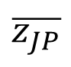
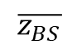
$$\overline{z_{BS}}$$
Notes:
So once you have fairly widespread torching of your mid-canopy layer, the question is – what will it take to jump up into the upper crown layer, and actually become more typically what we describe as a crown fire?
So – one big assumption here is that if we have involvement of the lower part of a stratum, fire will carry up through the crown; through the foliage of individual trees, and emit that convective and radiant energy from somewhere in the upper part of the crown.

Slide 24
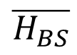
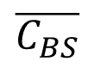


$$FSG=$$
$$z_{JP}−\left[z_{BS}+\frac{H_{BS}−z_{BS}}{2}\right]$$
$$\overline{z_{JP}}$$
$$\overline{H_{BS}}$$
$$\overline{C_{BS}}$$
$$\overline{D_{BS}}$$
$$\overline{z_{BS}}$$
Notes:
Figure 3:
So now we have a few calculations to make. And these are coded into the FuelGraph tool so you don’t have to worry about them
But basically what’s going on here is that we’re finding the centroid of the lower canopy and calculating the distance to the base of the upper canopy
So just like the surface fire emits radiative and convective energy from a height of zero, or a few cm, the lower stratum is assumed to emit most of its radiative and convective heat flux from a certain height. This could get very fancy, with models of tree crown shape and trying to figure out verticaly distributions and separating into several different layers. But to start with, we assume the middle of the crown.
The other thing we have to do is convert from live fuels to dead. Right? SFC is based on consumption of dead fuels in the litter and duff, and fine woody fuels on the ground.
So there are some equations to do this, and I’ve used a simple one from this fellow Babrauskas 2006, who burned Douglas-fir trees between about 0 and about 140 % moisture content and measured the heat output. So we use his equation to scale down from live fuel moisture to roughly dead fuel moisture levels. So we do need an estimate of FMC for that step.

Slide 25
$$FSG=$$
$$z_{JP}−\left[z_{BS}+\frac{H_{BS}−z_{BS}}{2}\right]$$
$$\overline{z_{JP}}$$
SFC scaled upwards to BS centroid (decreased)
$$\overline{H_{BS}}$$
$$\overline{C_{BS}}$$
$$\overline{D_{BS}}$$
$$\overline{z_{BS}}$$
Notes:
Figure 3
And the last part of this, not to be forgotten, the actual surface fuels
So we’re assuming and pretending the engagement of the upper canopy is a factor of the burning fuel from the lower layer and the contribution from the actual surface fuels, whose influence is decreased by this scaling factor, z^1.5.
And of course the actual FSG here is the gap between the crown centroid and the upper LCBH.
Maybe it should be 80% of the way up the tree or something, but in the present model it’s calculated at the midpoint of the crown layer

Slide 26

CCP: Next Steps and Beyond
Crown fires in light winds (<10 km/h)?
Don’t neglect other factors outside model:
atmospheric stability
understory live mc
litter/duff bulk density (how fluffy is your duff??)
Schwilk 2015:
Theoretical relationship between fuel BD and ROS
Notes:
Instability important in blow-ups;
Plume-dominated fires not well-predicted
Stands with developed understory herb & shrub – what do you do with those? Probably act as a wet blanket until a certain combination of time of year and drought level has been reached, then some of them become flammable; we don’t know those thresholds
Some controversy over how much duff consumption is actually involved in flaming combustion – some people say basically none, some say all of it
The FBP dataset assumes all of the consumed duff was involved
And that’s all!

